Slide 1

Session 7 – Python
Brief Intro to Machine Learning with Scikit Learn
Doug Bowman

Slide 2
Overview
Overview
  Intro Example Code
  Concepts and Definitions
  General Model Types
  Linear Models
  Dataset Preparation
  Evaluating Accuracy
  Ensemble Methods
  Tuning
  Bringing it All Together – Model Selection

Slide 3
Overview
Intro Example Code
  Build and run the first model built with the iris data set in ‘Machine Learning with Scikit-Learn.py’

Slide 4
Concepts and Definitions
Machine Learning
  The use of a model that learns from data to increase the predictive ability of an algorithm.
  Data by itself is not machine learning, since no learning can occur without assimilation of the data towards prediction.
  Data that cannot increase predictive capabilities of an algorithm is not machine learning—no learning occurs in this situation.

Slide 5
Concepts and Definitions
Trainers
  The mathematical equation, set of equations, and/or algorithm that is used to build a model.
  Examples:
    Classifiers
    Regressors

Slide 6
Concepts and Definitions
Classifier
  The trainers used to build models to predict outcomes for classification problems.
  For problems where we are trying to categorize something.
    i.e. trying to determine what kind of fruit something is.
    Trying to determine what kind of animal is in a picture.
  This is the scaffolding for our model.

Slide 7
Concepts and Definitions
Regressor
  The trainers used to build models that predict outcomes for regression problems.
  Problems were we are predicting a quantity within a range of values.
    i.e. Predicting the median household income in the future.
    How much thrust a new engine model will have.
  This is the scaffolding for our model.

Slide 8
Concepts and Definitions
Regressor
  In general, regressors predict by creating a function.
  For linear regressors, the function is similar to the following:
    Y_{predict} = w₁*f₁ + w₂*f₂ + w₃*f₃ + … + w_{n}*f_{n} + b + r
      Y_{predict} = predicted value for a given sample
      w = weights
      f = feature value
      n = number of features
      b = intercept of linear line
      r = regularization parameter
Notes:
Regularization parameter is used to adjust how the weight factors are optimized.
Different models either don’t use regularization, or use different methods for regularization.

Slide 9
Concepts and Definitions
Model
  The construct that is/will be trained and filled with data.
  This is what will tell us what the “answer” is.

Slide 10
Concepts and Definitions
Trainer vs Model
  The trainer is the template used to create a model.
  The model is what actually contains the data, where the trainer tells the model what to do with the data.
  The trainer is like a class, where the model is like an object.

Slide 11
Concepts and Definitions
Experience
  The incorporated data used to increase the effectiveness of the model’s predictions.

Slide 12
Concepts and Definitions
Feature
  A description of a set of like-data.
  This is usually represented as a column in a data table.
  Examples:
    Color of a fruit
    Length of a fruit
    Width of a fruit

Slide 13
Concepts and Definitions
Feature
  Examples continued:
    Past convictions when estimating if a person will commit a crime
    Family members with convictions when estimating if a person will commit a crime
    Convictions of local living area when estimating if a person will commit a crime

Slide 14
Concepts and Definitions
Sample
  A single set of data, or a data point.
  This is usually a row in a data table.

Slide 15
Concepts and Definitions
Label (Classification Problems)
  The name associated with a data point (row) for classification problems.
  This is generally the thing we are trying to predict.
  A.k.a. target
  Examples:
    ‘Apple’ if we are trying to predict a piece of fruit.
    ‘Yes/true’ if we are predicting if someone will commit a crime.

Slide 16
Concepts and Definitions
Training Data
  Data that is used to build our model.
  Data that is not used to test the accuracy of our model.

Slide 17
Concepts and Definitions
Test Data
  Data that is used to test the accuracy of a trained model.
  Separate from training data.

Slide 18
Concepts and Definitions
Overfitting
  Training a model so closely to training data that it does not model test data/other data as accurately.
  Usually indicated by a high accuracy on the training data, and an unreasonably low accuracy on the test data.
    The model will not be able to extrapolate or interpolate well.

Slide 19
Concepts and Definitions
Overfitting
  Possible Causes:
    Test data that is not sufficiently representative of the entire data spectrum.
    Tuning parameters adjusted too tightly to test data
    Extrapolating when only interpolating is relevant

Slide 20
Concepts and Definitions
Underfitting
  Training model not tight enough to test data and training data.
  Indicated by unreasonably low training and test data accuracy.
  Possible Causes:
    Tuning parameters not tuned enough.
    Incorrect features, or insufficient number of features, selected.

Slide 21
Concepts and Definitions
Decision Boundary
  The boundary between different categories in a classification problem.
  This is generated by the model.

Slide 22
General Model Types
Supervised
  Machine learning model is given a set of data to build experience with.
  Data is given with features, and an algorithm is given to the model on how to best categorize and group the data.

Slide 23
General Model Types
Unsupervised
  The model determines the data for itself, and builds the model accordingly.
  Features and grouping data is done by the algorithm.

Slide 24
General Model Types
Reinforcement
  The algorithm “learns” from making mistakes.
  There must be some sort of way to tell the algorithm when it makes a correction in the right direction, and a way to tell the algorithm a correction was made in the wrong direction.
  Initially, the model built is very inaccurate, but gets better with time.

Slide 25
General Model Types
This part of the Python course will focus on supervised learning, as this is all I know.

Slide 26
General Workflow
Get data
Build model
Evaluate predictive capabilities
Rebuild model, if needed
Predict real-world outcomes

Slide 27
General Workflow
Get Data
  Get set of data about what we wish to predict.
  Include the labels.

Slide 28
General Workflow
Build Model
  Select an appropriate classifier.
  The model should be trained with a majority of the data we gathered, say with 75% of the data.
  The other 25% can be used to test how good our model can predict.

Slide 29
General Workflow
Evaluate Predictive Capabilities
  The model needs to be evaluated for acceptable predictive capabilities to ensure our predictions will have a high degree of correctness.
  This is usually done using a sequestered set of data we use for testing.

Slide 30
General Workflow
Evaluate Predictive Capabilities
  There is no such thing as 100% accuracy unless you have toy data, or a completely defined system that does not need machine learning.
  If we get 100% accuracy, and the above are not true, we have most likely over-fitted our model, possibly by using training data as test data.
    Leads to inaccurate predictions on new data without known labels

Slide 31
General Workflow
Evaluate Predictive Capabilities
  Accuracy is not the only way to measure the predictive capabilities of a model.

Slide 32
General Workflow
Rebuild Model
  If the model isn’t suitable enough, we rebuild the model with more/better data, more tuned parameters, or using a different trainer.

Slide 33
General Workflow
Predict real-world outcomes
  Once we are happy with the predictive capability of our model, the model can be used to predict real-world outcomes that are unknown.

Slide 34
Linear Models
List of some types we will Cover
  Linear Classifiers
    K-Nearest Neighbors
    Decision Tree
    Logistic Regression
      Misleading name
    Support Vector Classifier

Slide 35
Linear Models
List of some types we will Cover
  Linear Regressors
    K-Nearest Neighbors
    Linear Regression
    Ridge Regression
    LASSO Regression
    Decision Tree
    Forest
    Gradient-Boosted Forest

Slide 36
Linear Models
Models differ in:
  How they create a decision boundary
  How they model accuracy
  Tuning/regularization they use

Slide 37
Linear Models - Classifiers
Classifiers
  Tries to predict a specific thing.
  Is either right or wrong for each prediction.
  Examples
    Predicting a type of fruit.
    Predicting a type of animal.
    Predicting a breed of dog.

Slide 38
Linear Models - Classifiers
K-Nearest Neighbors
  Predicts outcome by finding the closest matching data point neighbor(s) to the target point.
  When multiple neighbors are used, the classification with the most neighbors is what the target point is classified as.

Slide 39
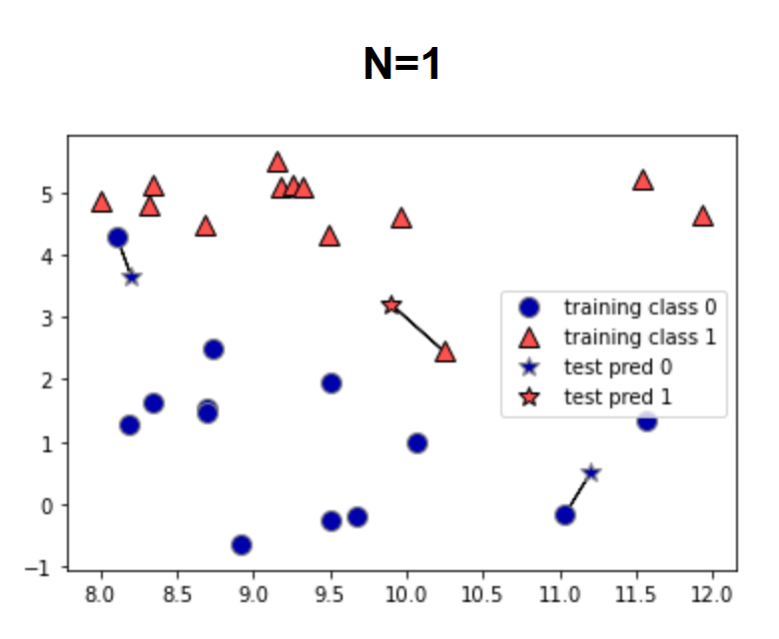
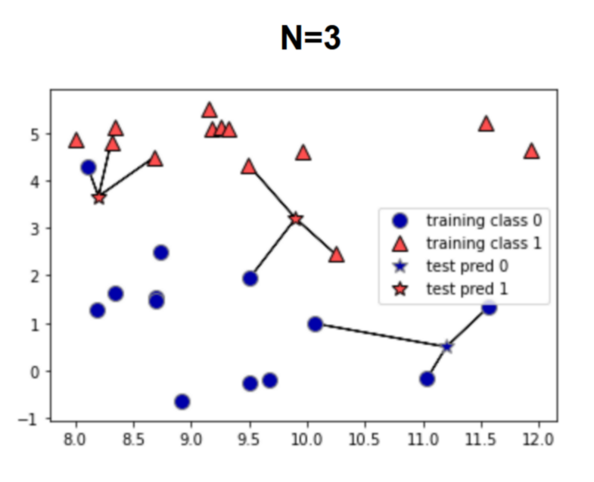
Linear Models - Classifiers
K-Nearest Neighbors
  Graphs below show decision, generated in source (1). The stars are the test data, and the model is predicting whether they are blue or red.

Slide 40
Linear Models - Classifiers
In-Class Exercise
  Run the classifier example with k-nearest neighbors and optimize based on number of neighbors.
    Use the .score() return value as your accuracy metric.

Slide 41
Linear Models - Classifiers
Decision Tree
  Builds a series of if-statements to classify test points.
  Boundaries around classifications are built based on the data.
  The number of if statement groups, or boundaries created, is known as the depth.

Slide 42
Linear Models - Classifiers
Decision Tree
  See file “./Session 7 – Python/Instructional Material/Class Examples/Scikit-Learn/decision_tree_graph.html“ for a representation of how the decision tree classifies from data.
    Generated from iris data set
    Code can be found in class example code under the decision tree section

Slide 43
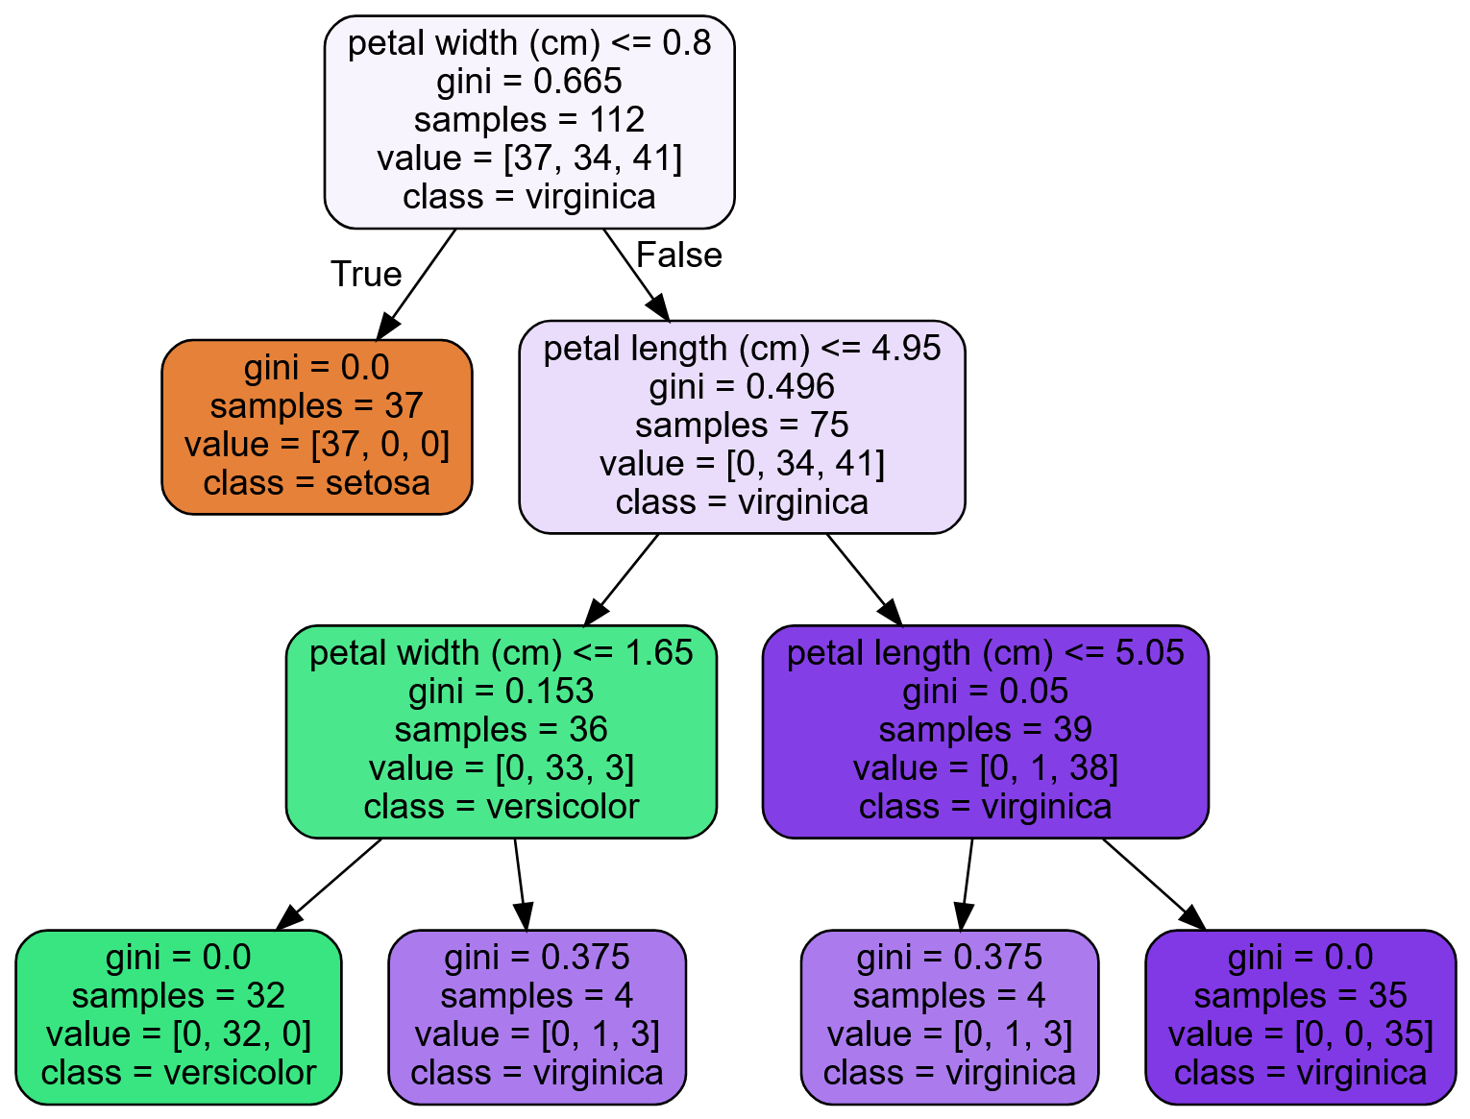
Linear Models - Classifiers
Decision Tree

Slide 44
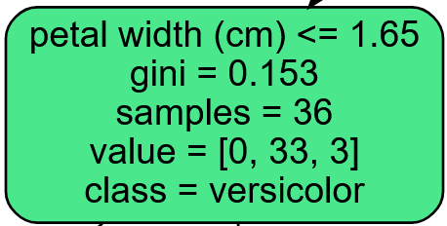
Linear Models - Classifiers
Decision Tree
  Attributes
    First line is the decision criteria for the children notes of the node the condition appears in.

Slide 45
Linear Models - Classifiers
Decision Tree
  Attributes
    Gini – A measure of the impurity of the node. 0 means all predictions are the same class, 1 means an infinite number of samples are classified in an infinite number of labels.

Slide 46
Linear Models - Classifiers
Decision Tree
  Attributes
    Gini
      = 1 -
      is the ratio of the predicted class to all samples of the kth class for the ith node.
      Closer to zero means most of the predicted labels are one class.
      Closer to one means the predicted labels are across more classes.

Slide 47
Linear Models - Classifiers
Decision Tree
  Attributes
    Gini
      The gini score is used in a cost function to determine which feature is used to create the decision boundary/condition for each node.

Slide 48
Linear Models - Classifiers
Decision Tree
  Attributes
    Samples – The number of training sets used to predict the current node.
    Value – The predicted classes with the given samples. This is in the order of the dataset label names.

Slide 49
Linear Models - Classifiers
Decision Tree
  Attributes
    Class – The predicted label of this node.

Slide 50
Linear Models - Classifiers
Decision Tree
  Tends to overfit the data.
  Can control this (regularize) by modifying the following parameters:
    max_depth
      The maximum depth the tree can go do.
    max_leaf_nodes
      Maximum number of leaves allowed in the model.
    max_features
      The number of features used in determining a node split.
Notes:
max_depth – The maximum number of node levels to generate.
max_leaf_nodes – The maximum number of leaves that can occur in the tree.
max_features – Maximum number of features that are evaluated for splitting each node.
min_samples_split – Minimum number of samples a node must have before it can split into another depth.
min_samples_leaf – The minimum number of samples a leaf node must have to exist.
min_weight_fraction_leaf – Same as min_samples_leaf, but uses a weighted fraction instead of sample count.

Slide 51
Linear Models - Classifiers
Decision Tree
  Tends to overfit the data.
  Can control this (regularize) by modifying the following parameters:
    min_samples_split
      Minimum number of samples in a node before a split can occur.
    min_samples_leaf
      Minimum number of samples needed in each produced leaf.
    min_weight_fraction_leaf
      The minimum weight with respect to the total weight a leaf can have in order for the leaf to exist.
Notes:
max_depth – The maximum number of node levels to generate.
max_leaf_nodes – The maximum number of leaves that can occur in the tree.
max_features – Maximum number of features that are evaluated for splitting each node.
min_samples_split – Minimum number of samples a node must have before it can split into another depth.
min_samples_leaf – The minimum number of samples a leaf node must have to exist.
min_weight_fraction_leaf – Same as min_samples_leaf, but uses a weighted fraction instead of sample count.

Slide 52
Linear Models - Classifiers
Decision Tree
  Sensitive to data
    Removing/adding one data point can drastically change the decision boundaries.
Notes:
max_depth – The maximum number of node levels to generate.
max_leaf_nodes – The maximum number of leaves that can occur in the tree.
max_features – Maximum number of features that are evaluated for splitting each node.
min_samples_split – Minimum number of samples a node must have before it can split into another depth.
min_samples_leaf – The minimum number of samples a leaf node must have to exist.
min_weight_fraction_leaf – Same as min_samples_leaf, but uses a weighted fraction instead of sample count.

Slide 53
Linear Models - Classifiers
Decision Tree
  Sensitive to data orientation
    This applies more for regression.
    Boundaries for decision trees are orthogonal (i.e. they are vertical or lateral, but not angled).
    Rotating the data points on a graph can drastically change the decision boundaries.
Notes:
max_depth – The maximum number of node levels to generate.
max_leaf_nodes – The maximum number of leaves that can occur in the tree.
max_features – Maximum number of features that are evaluated for splitting each node.
min_samples_split – Minimum number of samples a node must have before it can split into another depth.
min_samples_leaf – The minimum number of samples a leaf node must have to exist.
min_weight_fraction_leaf – Same as min_samples_leaf, but uses a weighted fraction instead of sample count.

Slide 54

Linear Models - Classifiers
In-Class Exercise
  Run the decision tree classifier example. Play with the depth to build accuracy, using at least 1-6 depths. Does accuracy continue to increase with depth? Why or why not?

Slide 55
Linear Models - Classifiers
Logistic Regression
  Used for classification, even though the name has “regression” in it.
  Works similar to other linear regressors, using a linear equation to generate decision boundaries/predict the label of the data point.

Slide 56
Linear Models - Classifiers
Logistic Regression
  Estimates probability that a sample belongs to a classification or not.
  If the probability is over 50%, then the sample is the label.
  Since this trainer can only tell if the sample either is the label or not, this trainer can only be used for binary classification.

Slide 57
Linear Models - Classifiers
Logistic Regression
  Uses regularization parameter c
  Logistic regression defaults to using L2 regularization, but L1 can be chosen.
    More will be discussed on regularization in the following section.

Slide 58
Linear Models - Classifiers
Logistic Regression
  High c value
    Less regularization
    Model tries to fit training set more closely
    Each feature is stressed in the weighting

Slide 59
Linear Models - Classifiers
Logistic Regression
  Low c value
    More regularization
    Each weight is brought closer to zero, which minimizes the importance of each individual feature on the overall label prediction.
    Model stresses generalization, and adjusts to hit the majority of points more than each one
      Too much regularization can cause the model to miss points that are close to both categories.

Slide 60
Linear Models - Classifiers
In-class Example
  Logistic Regression

Slide 61
Linear Models - Classifiers
In-Class Exercise
  Optimize c for logistic regression.

Slide 62
Linear Models - Classifiers
Regularization
  Trainers can use either a cost function to determine the weights of each feature, or a utility function.
    Cost functions should be minimized to determine weights.
    Utility functions should be maximized to determine weights.
  For this class, we will be using cost functions, such as Mean Squared Error or Ordinary Least Squares

Slide 63
Linear Models - Classifiers
Regularization
  A general cost function may look something like the following (Mean Squared Error):
    Cost = 1/n*[(Ŷ₁-Y₁)² + (Ŷ₂-Y₂)² + (Ŷ₃-Y₃)² + … + (Ŷ_{n}-Y_{n})²]
      Ŷ = predicted label
      Y = actual label
      n = number of samples
      w is the determined weight
      x is the feature value
      m is the number of features

Slide 64
Linear Models - Classifiers
Regularization
  This cost function is used to calculate the weight
    Our machine learning model will use specific parameters, along with adjusting the weights of each feature, to minimize the cost function.
      Learning rate
      Predicted outcomes/labels
      Actual outcomes/labels
    Once the cost function is minimized, the feature weights have been determined and our model is trained.

Slide 65
Linear Models - Classifiers
Regularization
  Regularization adds an additional r penalty to the cost function, driving the weights closer to 0.
    Cost = 1/n*[(Ŷ₁-Y₁)² + (Ŷ₂-Y₂)² + (Ŷ₃-Y₃)² + … + (Ŷ_{n}-Y_{n})²] + r
      Ŷ = predicted label
      Y = actual label
      n = number of samples
      r = regularization penalty to cost function
      w is the determined weight
      x is the feature value
      m is the number of features

Slide 66
Linear Models - Classifiers
Regularization
  Alternative notation
    J = + r
      J = Cost Function
      Ŷ = predicted label
      Y = actual label
      n = number of samples
      r = regularization penalty to cost function
      i = Sample index parameter

Slide 67
Linear Models - Classifiers
Regularization
  Alternative notation
      Ŷ = Predicted label for the given sample
      m = Number of features
      w = Weight values
      x = Feature values
      k = Feature index parameter

Slide 68
Linear Models - Classifiers
Regularization
  L1 Regularization
    r = α
      α is a hyperparameter used to adjust how fast the weights change (in the case of logistic regression, this is the c parameter)
        α = 1/c
      w is the weight of a feature
    Can cause the weights for features to go to 0

Slide 69
Linear Models - Classifiers
Regularization
  L2 Regularization:
    r = α ²
      α is a hyperparameter used to adjust how fast the weights change
        This is the c parameter in logistic regression
        α = 1/c
      w is the weight of a feature
    Weights for features cannot go to zero, but can get as close as needed

Slide 70
Linear Models - Classifiers
Regularization
  The general effect of regularization is to flatten a curve between all the data points.
    Causes the model to better generalize to the data.

Slide 71
Linear Models - Classifiers
Regularization
  The cost function can change, and regularization can still be applied.
  We used MSE as an example for this section:
    J = + r
  Ordinary Least Squares is another cost function that can be used:
    J = + r

Slide 72
Linear Models - Classifiers
Support Vector Machine (SVM) Classifiers
  Useful for small, complex datasets
  Types
    Linear
      Create boundary line by maximizing distance between two classes.
    Nonlinear
      Use feature engineering to generate more features

Slide 73
Linear Models - Classifiers
Linear SVM
  Attempts to create decision boundaries that maximize the space between the two closest samples.

Slide 74
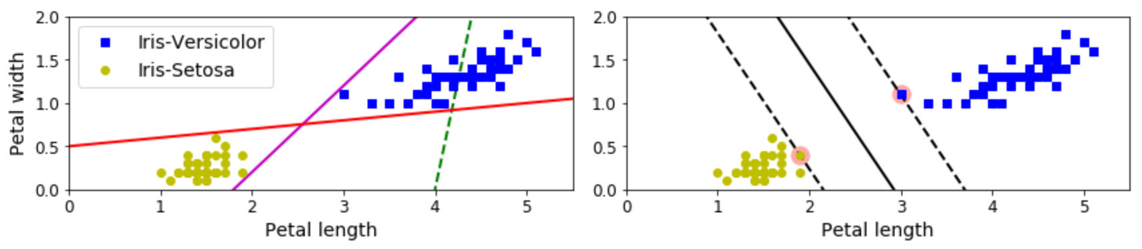
Linear Models - Classifiers
Linear SVM
  The left figure below shows individual linear classifier boundaries for multiple models
  The right figure shows the boundary for a linear SVM.
(4)

Slide 75
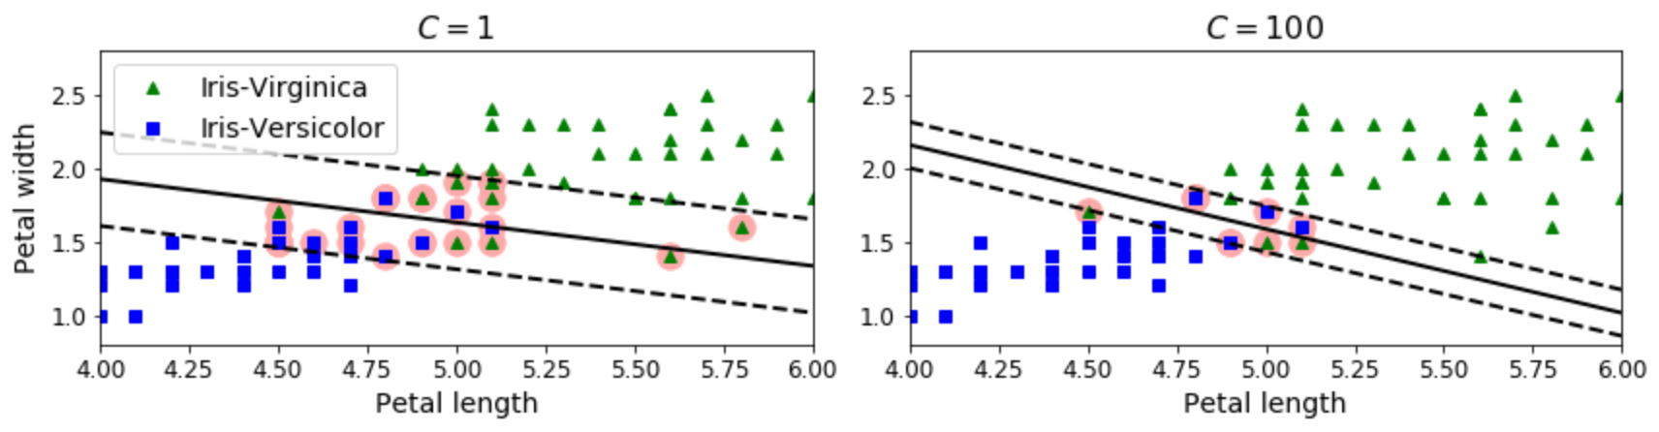
Linear Models - Classifiers
Linear SVM
  Support Vectors
    The points that generate the margin lines.
  Margin Violations
    Data points that are within the margins (dashed lines), even if they are on the correct side of the boundary.
(4)

Slide 76
Linear Models - Classifiers
Linear SVM
  Regularization
    Linear SVM’s use the c hyperparameter
    The c value changes the width of the margins from the boundary condition.
    Smaller c values increase the margins, which generalizes more

Slide 77
Linear Models - Classifiers
Linear SVM
  Regularization
    Smaller c values
      Increase the margins
      More generalized
      More margin violations
    Larger c values
      Smaller margins
      Fewer margin violations
      Less generalization
      Higher chance of overfitting to training data

Slide 78
Linear Models - Classifiers
Linear SVM
  Regularization
(4)

Slide 79
Linear Models - Classifiers
In-class Example
  Linear SVM

Slide 80
Linear Models - Classifiers
In-Class Exercise
  Use LinearSVM, adjusting C to see how this affects accuracy and generalization.

Slide 81
Linear Models - Classifiers
Nonlinear SVM
  Used when classes are not linearly separable.
  Multiple ways to deal with this.

Slide 82
Linear Models - Classifiers
Nonlinear SVM
  Feature Addition
    Adding more features can allow the data to be linearly separable.

Slide 83
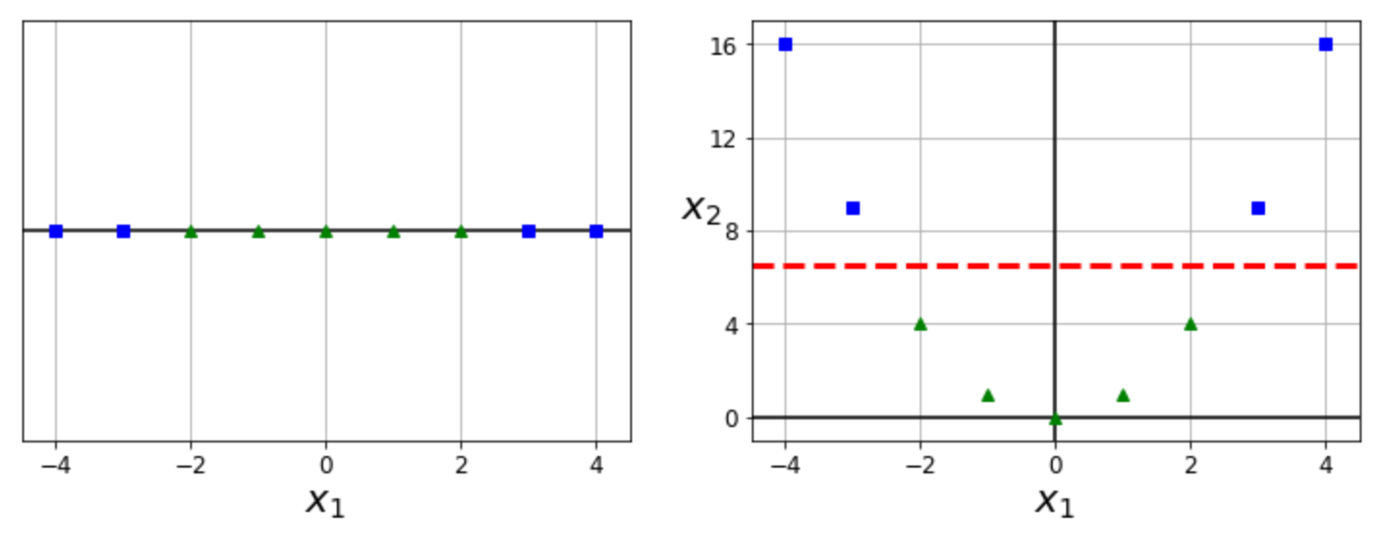
Linear Models - Classifiers
Nonlinear SVM
  Feature Addition
    The right figure results from creating a new parameter based on the squared value of the x₁ parameter.
(4)

Slide 84
Linear Models - Classifiers
Nonlinear SVM
  Feature Addition
    This new feature allows for a linearly separable boundary between the two classes.
(4)

Slide 85
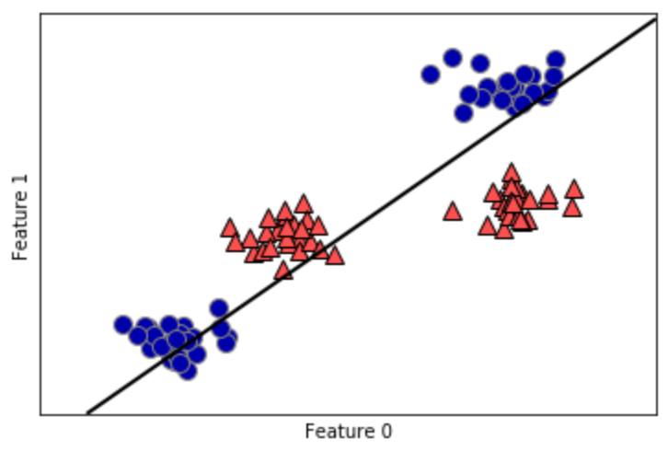
Linear Models - Classifiers
Nonlinear SVM
  Feature addition transforms this (see reference 1):
(1)

Slide 86
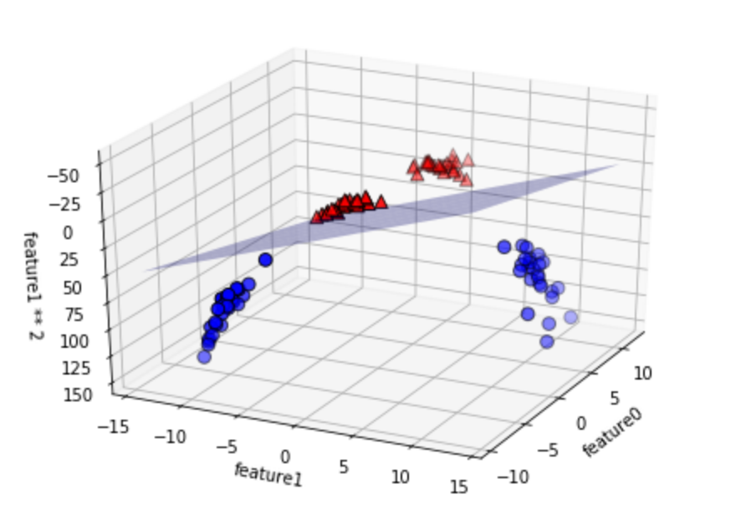
Linear Models - Classifiers
Nonlinear SVM
  To this (see reference 1):
(1)
Notes:
It is almost like the previous slide is showing a projection of this graph along just the feauture1-feature0 plane.

Slide 87
Linear Models - Classifiers
Nonlinear SVM
  Feature Addition
    Methods:
      Polynomial
      Similarity Function

Slide 88
Linear Models - Classifiers
Nonlinear SVM
  Feature Addition Using Polynomial Functions
    Addition of features using a polynomial function with another feature as an input.
    A polynomial function is of the form:
    The previous figures show graphical examples using polynomial functions.

Slide 89
Linear Models - Classifiers
Nonlinear SVM
  Feature Addition using Similarity Function
    A similarity function is used vs a polynomial function.
    The similarity function measures how much each feature data point resembles a user-specified landmark.
      The closer the data point is to a landmark, the higher the value from the similarity function.
      Can select as many feature data points to be landmarks as desired, but this increases the amount of data to predict from.
      The more landmarks chosen, the higher the linearity of the data since the number of dimensions increases.

Slide 90
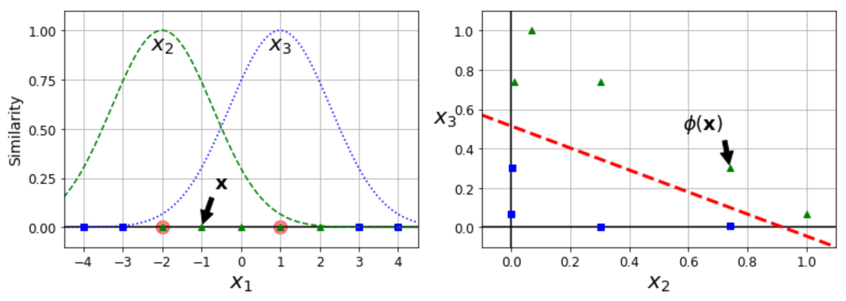
Linear Models - Classifiers
Nonlinear SVM
  Feature Addition using Similarity Function
    The following example uses the Gaussian Radial Basis Function as the similarity function, as an example.
(4)

Slide 91
Linear Models - Classifiers
Nonlinear SVM
  Feature Addition using Similarity Function
    The landmarks chosen here are -2 and 1.
(4)

Slide 92
Linear Models - Classifiers
Nonlinear SVM
  gamma (γ) hyperparameter
    Used for Gaussian RBF kernel
    Causes width of bell curves to tighten
    Causes decision boundary to wrap more tightly around the targeted class/landmarks.
    Acts like the hyperparameter c
    Higher values decrease generalization, and attempt to more exactly fit the data
    Lower values increase generalization.

Slide 93
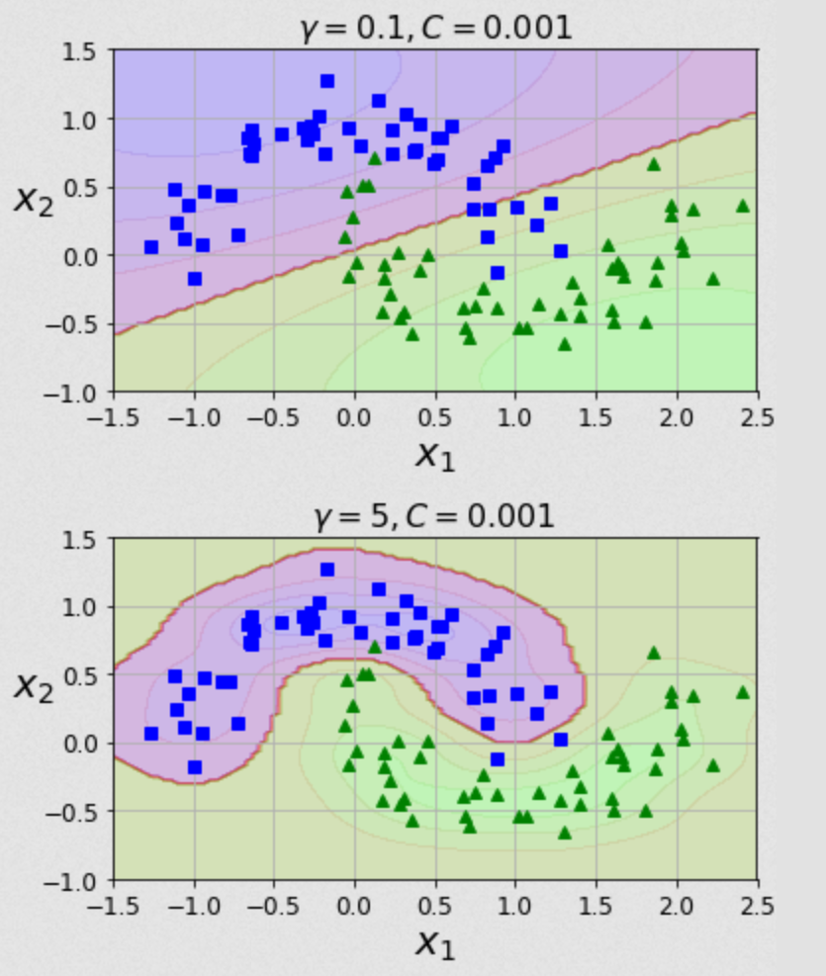
Linear Models - Classifiers
Nonlinear SVM
  gamma (γ)
hyperparameter
(4)

Slide 94
Linear Models - Classifiers
Nonlinear SVM
  Kernel Trick
    Adding more features can allow the data to be linearly separable, but also increases the amount of computational power needed.
    The kernel trick does some mathematical trickery to map the prediction function to a different space.
    Mapping the function to a different space allows a less computationally expensive calculation vs computing values for the function itself.
    This decreases the needed computational power.

Slide 95
Linear Models - Classifiers
Nonlinear SVM
  Kernel Trick
    Different kernels can be used, including for polynomial and similarity function methods covered above.
    See code for examples.

Slide 96
Linear Models - Classifiers
In-class Example
  Nonlinear SVM using feature addition
  Nonlinear SVM using kernels

Slide 97
Linear Models - Classifiers
In-Class Exercise
  Optimize the polynomial degree for nonlinear SVM using the polynomial kernel.
  Use the RBF kernel with the nonlinear SVM, adjusting gamma and C to see how they affect accuracy and generalization.

Slide 98
Linear Models - Regressors
Regressors
  Tries to predict an unbounded value as accurately as possible vs predicting a specific class.
  Creates a linear equation to predict outcomes:
    Y_{predict} = w₁*f₁ + w₂*f₂ + w₃*f₃ + … + w_{n}*f_{n} + b
      Y_{predict} = predicted value for given sample
      w = weights
      f = feature value
      b = intercept of linear line
      n = number of features
    A.k.a the prediction function.

Slide 99
Linear Models - Regressors
Regressors
  The models we train adjust the values of w_{x} and b.
  For functions with regularization, an additional hyperparameter is added to guide model convergence when generating the prediction function.
  Examples:
    Trying to predict median household income of an area.
    Trying to predict the value a stock will rise to.

Slide 100
Linear Models - Regressors
K-Nearest Neighbors Regression
  Similar to the classifier variant, the regressor picks the value that is closest to the most similar neighbor.
  Multiple neighbors are averaged together.
    Option to weight the average, such as weighting neighbors inversely to their distance from the point to predict.

Slide 101
Linear Models - Regressors
Linear Regression (Ordinary Least Squares)
  Attempts to minimize the mean squared error between the prediction and the target values.
  The error of this trainer is calculated by adding the squared differences between the predicted value with the actual target value.
  No regularization parameters to adjust the accuracy of this trainer.

Slide 102
Linear Models - Regressors
Linear Regression (Ordinary Least Squares)
  Cost = [(Ŷ₁-Y₁)² + (Ŷ₂-Y₂)² + (Ŷ₃-Y₃)² + … + (Ŷ_{n}-Y_{n})²] =
    Ŷ = predicted label
    Y = actual label
    n = number of samples
  =
    w is the determined weight
    x is the feature value
    m is the number of features

Slide 103
Linear Models - Regressors
In-Class Example – Linear Regression

Slide 104
Linear Models - Classifiers
In-Class Exercise
  Run a linear regression prediction on the Boston housing data set.

Slide 105
Linear Models - Regressors
Ridge Regression
  Uses a modified Ordinary Least Squares as the cost function to fit the data.
  Adds additional constraint of attempting to minimize the magnitude of the weight coefficients for each feature without eliminating the feature.

Slide 106
Linear Models - Regressors
Ridge Regression
  Each weight should be as close to zero as possible.
  Each feature will have as little affect on the prediction as possible.
  Note that the feature weights will not be exactly zero using this trainer, so each feature still affects the prediction.

Slide 107
Linear Models - Regressors
Ridge Regression
  Attempting to minimize the weight magnitudes is a form of regularization.
    Regularization is used to attempt to prevent overfitting.
  This trainer uses L2 regularization with OLS as the cost function
    The sum of the square of the weight coefficient for each feature is used as a penalty term in determining model accuracy.

Slide 108
Linear Models - Classifiers
Ridge Regression
  Ordinary Least Squares with Regularization
    Cost =
      Ŷ = predicted label
      Y = actual label
      n = number of samples
      i = feature index
      j = weight index
      α = regularization hyperparameter, must be >=0
      m = number of features
      w = determined weight

Slide 109
Linear Models - Classifiers
Ridge Regression
  Ordinary Least Squares with Regularization
      w is the determined weight
      x is the feature value
      m is the number of features

Slide 110
Linear Models - Regressors
Ridge Regression
  For this Scikit-Learn trainer, alpha is the hyperparameter used for regularization.
  Increasing alpha moves each feature’s weight more towards zero.
    This may help make the model more generalized, which will help overfitting.
    This will decrease training set performance.

Slide 111
Linear Models - Regressors
Ridge Regression
  Increasing alpha more and more will not necessarily make the model more predictive.
  Alpha will need tuned for an optimal model.

Slide 112
Linear Models - Regressors
In-Class Example – Ridge Regression

Slide 113
Linear Models - Regressors
In-Class Exercise
  Run the example with ridge regression, attempting to optimize the test prediction data set by adjusting alpha.

Slide 114
Linear Models - Regressors
LASSO Regression
  Least Absolute Shrinkage and Selection Operator
  Similar to ridge regression, uses a modified Ordinary Least Squares algorithm as the cost function.
  Attempts to make each weight close to zero.
  In this trainer, a weight value can be zero, so that a feature will not affect the prediction.

Slide 115
Linear Models - Regressors
LASSO Regression
  This trainer uses L1 regularization.
    The sum of the weight coefficient for each feature is used as a penalty term in determining model accuracy.
  Alpha is the hyperparameter used for regularization.

Slide 116
Linear Models - Classifiers
LASSO Regression
  Ordinary Least Squares with Regularization
    Cost =
      Ŷ = predicted label
      Y = actual label
      n = number of samples
      i = feature index
      j = weight index
      α = regularization hyperparameter, must be >=0
      m = number of features
      w = determined weight

Slide 117
Linear Models - Classifiers
LASSO Regression
  Ordinary Least Squares with Regularization
      w is the determined weight
      x is the feature value
      m is the number of features

Slide 118
Linear Models - Regressors
In-Class Example – LASSO Regression

Slide 119
Linear Models - Regressors
In-Class Exercise
  Generate models for the boston housing data using linear, ridge, and LASSO regressors. For models that use regularization, attempt to optimize the predictions (can use previous example code).
  Which model is the most accurate with respect to test data predictions? Are there benefits to the models that are less accurate?

Slide 120
Linear Models - Regressors
Decision Tree
  Works similar to classifier, except:
    Mean squared error is used in cost function to determine boundaries vs impurity (Gini) score.
    Instead of classes, value ranges differentiate levels of model.

Slide 121
Linear Models - Regressors
Decision Tree
  Each node has a predicted value that is the average of all values within its decision boundary.
    This is represented by the “value” parameter in each node.

Slide 122
Linear Models - Regressors
Decision Tree
  The same pros and cons exist as the classifier variant of the decision tree.
  See class example .dot file outputs for decision tree visualizations.

Slide 123
Linear Models - Regressors
In-Class Exercise
  Run the decision tree regressor example. As with the classifier example, play with the depth to see how accuracy is affected.

Slide 124
Linear Models - Regressors
In-Class Exercise
  Adjust the following hyperparameters to see their effect:
    max_depth
    max_leaf_nodes
    max_features
    min_samples_split
    min_samples_leaf
    min_weight_fraction_leaf

Slide 125
Dataset Preparation
Overview
  Train Test Split
  Cross Validation
  Scaling Data
  Converting Categories to Numbers
  Estimating Missing Values
  Checking Feature Correlation
  Manually Engineering Features

Slide 126
Dataset Preparation
Train Test Split
  Simple way to get training data and test data
  Standard 75% training, 25% test data can be tweaked
  Data by default is shuffled before splitting
  Data can be stratified

Slide 127
Dataset Preparation
In-Class Exercise
  Adjust the training and test split, and see how accuracy changes with a model of your choice:
    test_size = 20, train_size = 80
    test_size = 30, train_size = 70
    test_size = 25, train_size = 50

Slide 128
Dataset Preparation
Cross Validation
  When working with train test split, sometimes information can still be pushed back into the model and affect the test data set
    Can happen with hyperparameters

Slide 129
Dataset Preparation
Cross Validation
  One option is to split the data into 3 sets:
    Training data
    Validation data
      Now used as our new test data to tune the model
    Test data
      Used after the model is optimized for final accuracy check
  This unfortunately greatly reduces the training data set, and can decrease model effectiveness.

Slide 130
Dataset Preparation
Cross Validation
  Another option is to take multiple smaller cuts of the training data, called folds.
  With k folds, k-1 folds are used for training and one is used for validation.
  There will be k different scores, one for using each fold as the validation set once.
  The resulting score can be calculated by taking the mean score.

Slide 131
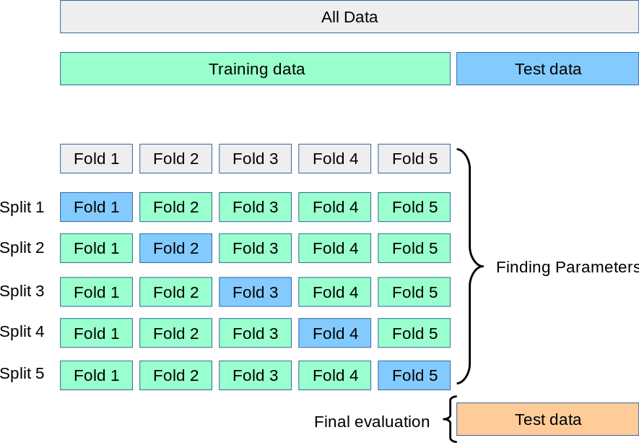
Dataset Preparation
Cross Validation
(8)

Slide 132
Dataset Preparation
In-Class Exercise
  Create a model with your choice of model and data. Using the cross_val_score method, adjust the number of folds, noting the following:
    How does the mean score change?
    How does the standard deviation change?
      Is this important?
    How does computational time change?

Slide 133
Dataset Preparation
Scaling Data
  Changing the values of the training data set in such a way to normalize, or convert the data into a specific range.
  Certain algorithms are more sensitive to data scaling:
    SVM
    K-nearest neighbors
    Logistic regression

Slide 134
Dataset Preparation
Scaling Data
  Scaling is more of an art form—there is no standard procedure that will increase accuracy for all models via scaling.

Slide 135
Dataset Preparation
Scaling Data
  Types of scalers
    Min Max Scaler (MinMaxScaler)
      Values scaled between 0 and 1
      Adversely affected by outlier values

Slide 136
Dataset Preparation
Scaling Data
  Types of scalers
    Standard Scaler (StandardScaler)
      Resulting distribution has a std dev = 1
      Resulting distribution has a variance = 1
      StandardScaler makes the mean ~ 0.
      Adversely affected by outlier values

Slide 137
Dataset Preparation
Scaling Data
  Types of scalers
    Robust Scaler (RobustScaler)
      Scales data to the interquartile range
        Interquartile range = Q3 – Q1
        Q3 is the value where 75% of the data occurs before the value, when the data is ordered.
        Q1 is the value where 25% of the data occurs before the value, when the data is ordered.
      Well suited for data sets with outliers

Slide 138
Dataset Preparation
Scaling Data
  Types of scalers
    For more scalers, and a visual comparison, see https://scikit-learn.org/stable/auto_examples/preprocessing/plot_all_scaling.html#sphx-glr-auto-examples-preprocessing-plot-all-scaling-py

Slide 139
Dataset Preparation
Scaling Data
  When scaling data, ensure both the training data and the test data are scaled.
    Test performance will plummet if it is not scaled as well.
  Ensure real-world data inputted into the model is also scaled.

Slide 140
Dataset Preparation
In-Class Exercise
  Using any chosen data set, scale model data of your choice using the 3 covered scalers:
    MinMaxScaler
    StandardScaler
    RobustScaler

Slide 141
Dataset Preparation
In-Class Exercise
  Apply each scaled set of data to a classifier and regressor data set.
    Suggest to try the scalers out on an SVM, or other sensitive classifier trainer.

Slide 142
Dataset Preparation
Converting Categories to Numbers
  Trainers understand numbers better than text. If there are a set number of text categories, converting them to numbers will help.
  If you have 5 categories, replacing them with numbers will make the model more accurate and/or more efficient.
    ‘Lake’ → 0
    ‘River’ → 1
    ‘Stream’ → 2
    ‘Ocean’ → 3
    ‘Pond’ → 4

Slide 143
Dataset Preparation
Converting Categories to Numbers
  Scikit-learn provides a transformer for this
    LabelEncoder
    Apply the encoder to each column of the data set that has categorical strings.
    Do this before splitting the data into training and testing data.

Slide 144
Dataset Preparation
Converting Categories to Numbers
  Go over in-class example using housing.csv data.

Slide 145
Dataset Preparation
In-Class Exercise
  Using the data at ‘./Session 7 - Python/Instructional Material/In-Class Exercises/Data/Inflation 1980-2020.csv’, load the data into Python and encode one of the category-based columns (such as the “LOCATION” column).

Slide 146
Dataset Preparation
Converting Categories to Numbers
  One issue with this is that some algorithms will assume numbers closer to each other will be more similar.

Slide 147
Dataset Preparation
Converting Categories to Numbers
  For example, look at the following data representing food:
    chicken → 0
    raspberries → 1
    salmon → 2
    turkey → 3
    yogurt → 4
  If we were trying to predict nutritional content of food, our model may assume chicken and raspberries are more related than chicken and turkey since the indices of chicken and raspberries are closer together.

Slide 148
Dataset Preparation
Converting Categories to Numbers
  One solution to this is to create a new feature for each numerical category, with a possible value of either 1 or 0.
    Instead of having one column that could have a value within the range [0,4], there would be 5 new columns each representing one of the values in the original column.
    Each new column will have a value of either 1 or 0
    This is called one-hot encoding.
      Scikit-Learn uses the OneHotEncoder transformer to handle this

Slide 149
Dataset Preparation
Converting Categories to Numbers
  Go over in-class example of one-hot encoding using housing.csv data.

Slide 150
STOPPED HERE

Slide 151
Dataset Preparation
In-Class Exercise
  Using the data at ‘./Session 7 - Python/Instructional Material/In-Class Exercises/Data/Inflation 1980-2020.csv’, use the one-hot encoder to create multiple columns from one of the category-based columns (such as the “LOCATION” column).

Slide 152
Dataset Preparation
Converting Categories to Numbers
  To apply both binary encoder and one-hot encoder in one go, we can use the LabelBinarizer transformer.
  Note that for each of these methods, the output is an array of just the transformed column, not the entire data set including the new data.
    The transformed column data will need added back to the original data.

Slide 153
Dataset Preparation
Converting Categories to Numbers
  Go over in-class example of label binarizer encoding using housing.csv data.

Slide 154
Dataset Preparation
In-Class Exercise
  Using the data at ‘./Session 7 - Python/Instructional Material/In-Class Exercises/Data/Inflation 1980-2020.csv’, apply the LabelBinarizer and check the output against the sequential application of the LabelEncoding and OneHotEncoding methods in the previous exercise.
    This is more of a quick exercise to check for DataFrame and 2D array equality

Slide 155
Dataset Preparation
In-Class Exercise
  Train a model with both the string categories, and then with numerical categories.
    How is accuracy affected by converting the string categories to numerical categories?
    How is the speed affected by converting the string categories to numerical categories?

Slide 156
Dataset Preparation
Estimating Missing Values
  Missing values can throw off the accuracy of your model.
  Missing values can be interpreted as nan values (example on next slide)

Slide 157
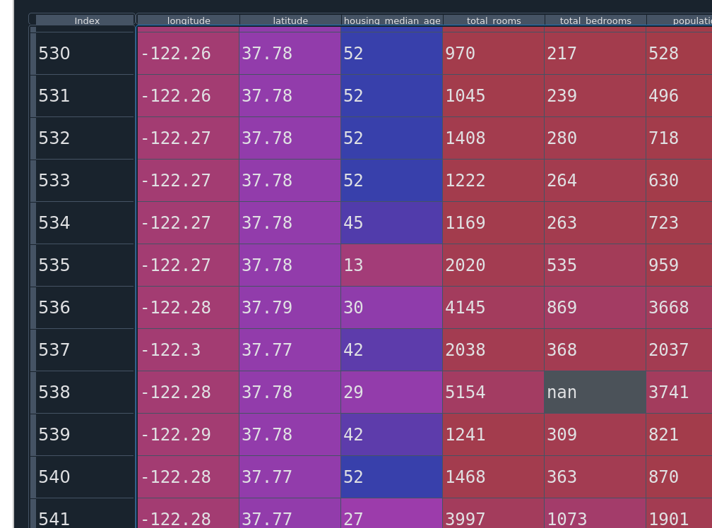
Dataset Preparation
Estimating Missing Values
Example of nan value in DataFrame shown within the data explorer of Spyder.

Slide 158
Dataset Preparation
Estimating Missing Values
  Scikit-learn utilizes the Imputer class to fill in missing data.
    In newer versions, use SimpleImputer.
  Can chose how you want missing values estimated.

Slide 159
Dataset Preparation
Estimating Missing Values
  Options for estimation:
    mean
    median
    most_frequent

Slide 160
Dataset Preparation
Estimating Missing Values
  Imputer only works on numerical values, not strings.
  If strings exist, they must be converted to numerical values or the columns must be removed.

Slide 161
Dataset Preparation
Estimating Missing Values
  Reminder/note: the import statement “from sklearn.preprocessing import Imputer” was deprecated with scikit-learn v0.20.4 and removed as of v0.22.2.
  Use “from sklearn.impute import SimpleImputer” instead

Slide 162
Dataset Preparation
Estimating Missing Values
  Go over Imputer example in class.

Slide 163
Dataset Preparation
In-Class Exercise
  For each column that has nan values, convert them to an estimated value using an imputer.
    Use any strategy you wish.
  Train a machine learning model with the imputed data.
    Remember how the model assumes correlations for numbers that are close together.

Slide 164
Dataset Preparation
Checking Feature Correlation
  We can check how closely correlated two features are with each other.
    One reason is to see how much changing one feature will affect another
      Such as a feature vs the collected target values.
    Another reason might be in deciding whether certain features can be removed from the data.
    Another reason might be in deciding how useful an engineered feature is.

Slide 165
Dataset Preparation
Checking Feature Correlation
  Use the .corr() method of a pandas DataFrame
    Creates a correlation matrix, showing correlations between each feature with all other features.
    Same as Pearson’s R correlation.
    Only for linear correlations.

Slide 166
Dataset Preparation
Checking Feature Correlation
  Use the .corr() method of a pandas DataFrame
    Ranges from [-1,1]
    Closer to 0 means the feature has less affect.
    Closer to 1 means increasing the feature increases the prediction, decreasing the feature decreases the prediction.
    Closer to -1 means increasing the feature decreases the prediction value, and vice versa.
  feature_importance_ of a predictor?

Slide 167
Dataset Preparation
Checking Feature Correlation
  scipy Correlation Functions
    Pearson’s R Correlation
      Returns two values
        R value, as with the DataFrame.corr()
        Two-tailed p-value (see citation 11)
      For linear correlations
      Assumes normal distribution between features
      scipy.stats.pearsonr(iterable_1, iterable_2)
      Will not show non-linear correlations

Slide 168
Dataset Preparation
Checking Feature Correlation
  scipy Correlation Functions
    Spearman’s Correlation
      Returns two values:
        Correlation value
        P-value “hypothesis test whose null hypotheisis is that two sets of data are uncorrelated.” (see citation 12)
      For non-linear correlations
      Does not assume features are normally distributed
      scipy.stats.spearmanr(iterable_1, iterable_2)
      Will also show linear correlations, but the magnitude will not be as high as with Pearson’s

Slide 169
Dataset Preparation
Checking Feature Correlation
  How do we use correlation functions?
  Compare feature with trained targets.

Slide 170
Dataset Preparation
Manually Engineering Features
  Just like with SVM, can create new features from existing features.
  For instance, in housing data, maybe number of rooms and number of bedrooms is given. Maybe the number of bedrooms/number of rooms will be a better feature.
  Use correlation coefficients to determine if the new features are useful or not.

Slide 171
Dataset Preparation
In-Class Exercise
  Start with creating a basic LinearRegressor model, and train it using train_test_split. Get and store the initial accuracy values for the test set and training set.

Slide 172
Dataset Preparation
In-Class Exercise
  Apply each of the following steps, checking the accuracy after each step is applied:
    Cross validation instead of train test split
    Scale the data
    Converting any string categories to numbers
    Remove weak features using correlation coefficients
    Manually engineer some new features, checking their effectiveness using correlation coefficients.

Slide 173
Evaluating Accuracy of Classifiers
Overview
  Why accuracy isn’t enough
  Precision
  Recall (True Positive Rate, Sensitivity)
  False Positive Rate
  Specificity (True Negative Rate)
  Confusion Matrix
  Accuracy

Slide 174
Evaluating Accuracy of Classifiers
Overview
  Precision Recall Curves
    precision_recall_curve()
  Receiver Operating Characteristics (ROC) Curve
    roc_curve()
  Area Under the Curve (AUC)
    roc_auc_score()
  Mean Squared Error
    mse

Slide 175
Evaluating Accuracy of Classifiers
Why accuracy alone isn’t enough
  Skewed datasets
    If the dataset contains many more targets of one classification vs another, it is very easy to get high accuracy by just guessing the most likely class.

Slide 176
Evaluating Accuracy of Classifiers
Why accuracy alone isn’t enough
  High importance of not getting false positives or false negatives
    Predicting a false negative for something like cancer recognition is much less preferred than predicting a false positive.
      i.e. we would rather have the model incorrectly predict a benign tumor is malignant vs predict a malignant tumor benign.

Slide 177
Evaluating Accuracy of Classifiers
Except for mean squared error, all of these methods apply to classification trainers and models.

Slide 178
Evaluating Accuracy of Classifiers
Precision
  TP/(TP+FP)
    Represents number of correct classifications of the positive class over all predictions of the positive class
  Can achieve 100% if a single prediction is made and it is correct.
    Must look at other metrics.

Slide 179
Evaluating Accuracy of Classifiers
Recall
  TP/(TP+FN)
    Represents correct predictions of the positive class over true number of positive class data points.
  A.k.a. True Positive Rate
  A.k.a. Sensitivity

Slide 180
Evaluating Accuracy of Classifiers
False Positive Rate
  FP/(TP+FN) = 1-TNR

Slide 181
Evaluating Accuracy of Classifiers
True Negative Rate
  TN/(TN+FP) = 1-FNR

Slide 182
Evaluating Accuracy of Classifiers
Increasing precision decreases recall, and vice versa.

Slide 183
Evaluating Accuracy of Classifiers
Accuracy
  (TP + TN)/(TP + TN + FP + FN)

Slide 184
Evaluating Accuracy of Classifiers
Confusion Matrix
  2-dimensional data table
  Measure of how “confused” our model is.
  Each cell shows how many classifications were predicted, and what the actual target was.
  Rows are actual targets
  Columns are predicted targets

Slide 185
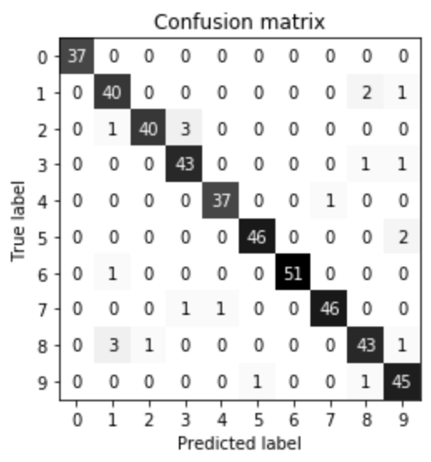
Evaluating Accuracy of Classifiers
Confusion Matrix
  Example

Slide 186
Evaluating Accuracy of Classifiers
Precision Recall Curves

Slide 187
Evaluating Accuracy of Classifiers
Receiver Operating Characteristics (ROC) Curve
  Plots True Positive Rate vs False Positive Rate

Slide 188
Evaluating Accuracy of Classifiers
Area Under the Curve (AUC)

Slide 189
Evaluating Accuracy of Regressors
Overview
  Mean Squared Error
  Coefficient of Determination ()
  Residuals Plot
  Prediction Error Plot

Slide 190
Evaluating Accuracy of Regressors
Mean Squared Error

Slide 191
Evaluating Accuracy of Regressors
Coefficient of Determination ()

Slide 192
Evaluating Accuracy of Regressors
Residuals Plot

Slide 193
Evaluating Accuracy of Regressors
Prediction Error Plot

Slide 194
Ensemble Methods
Overview
  Voting Classifiers
  Bagging and Pasting
  Random Forests
  Boosting
  Stacking

Slide 195
Ensemble Methods
Overview
  It is important to choose very different algorithms for each trainer. This will prevent any single type of error from growing too large, and will allow each error to be voted out from the other trainers.

Slide 196
Ensemble Methods
Voting Classifiers
  Train multiple different classifiers.
  Using the VotingClassifier, have each classifier vote on what the predicted label should be.

Slide 197
Ensemble Methods
Voting Classifiers
  Hard vs Soft Voting
    Hard is a simple vote
    Soft voting calculates the class probabilities from each model, averages them over all individual models. The highest probability is the estimated class.
      Requires trainers that have the predict_proba() method.

Slide 198
Ensemble Methods
Bagging and Pasting

Slide 199
Ensemble Methods
Random Forests
  Decision trees tend to overfit
  Use multiple, slightly different models to increase predictive capability.
  Can be used for either classifiers or regressors.

Slide 200
Ensemble Methods
Boosting

Slide 201
Ensemble Methods
Stacking

Slide 202
Tuning
Determining what features matter
If both prediction test scores and training scores are low, then the model is suffering from underfitting.
If the model has extremely high training scores, but not nearly as high prediction test scores, the model is suffering from overfitting.

Slide 203
Tuning
Grid Search

Slide 204
Tuning
Parameters to Play with
  K-Nearest Neighbors
    Number of neighbors to test point
    Algorithm to evaluate distance test point is from data points

Slide 205
Tuning
Parameters to Play with
  Decision Trees
    max_depth
    max_leaf_nodes
    max_features
    min_samples_split
    min_samples_leaf
    min_weight_fraction_leaf

Slide 206
Tuning
Parameters to Play with
  alpha
    Higher values increase regularization/generalization
    Higher value pushes feature weights closer to zero
    Lasso Regression
    Ridge Regression

Slide 207
Tuning
Parameters to Play with
  c
    Lower values increase generalization
    Higher value causes algorithm to attempt to fit each training data point as best as possible
    Logistic regression
    Linear support vector machine

Slide 208
Tuning
Parameters to Play with
  gamma
    Lower values increase generalization, reducing overfitting.
    Higher value causes algorithm to attempt to fit each training data point as best as possible, reducing generalization.
    Linear support vector machine

Slide 209
Tuning
Parameters to Play with
  c and alpha are known as hyperparameters.
    Hyperparameters are parameters that are set before a model is trained, and stays constant throughout the learning process.

Slide 210

Bibliography
https://github.com/amueller/introduction_to_ml_with_python/blob/master/02-supervised-learning.ipynb
Müller, A. C., & Guido, S. (2016). Introduction to Machine Learning with Python: A Guide for Data Scientists (1st ed.). O’Reilly Media.
http://rasbt.github.io/mlxtend/user_guide/general_concepts/gradient-optimization/

Slide 211
Bibliography
https://github.com/ageron/handson-ml
Géron Aurélien. Hands-on Machine Learning with Scikit-Learn and Tensorflow. 1st ed., O'Reilly, 2017.
https://machinelearningmastery.com/how-to-use-correlation-to-understand-the-relationship-between-variables/

Slide 212
Bibliography
Harrison, Matt. Machine Learning Pocket Reference: Working with Structured Data in Python. 1st ed., O'Reilly, 2019.
https://scikit-learn.org/stable/modules/cross_validation.html
Scikit-learn: Machine Learning in Python, Pedregosa et al., JMLR 12, pp. 2825-2830, 2011.

Slide 213
Bibliography
API design for machine learning software: experiences from the scikit-learn project, Buitinck et al., 2013.
https://docs.scipy.org/doc/scipy/reference/generated/scipy.stats.pearsonr.html
https://docs.scipy.org/doc/scipy/reference/generated/scipy.stats.spearmanr.html#scipy.stats.spearmanr

Slide 214
Additional Resources
https://towardsdatascience.com/over-fitting-and-regularization-64d16100f45c
https://towardsdatascience.com/scale-standardize-or-normalize-with-scikit-learn-6ccc7d176a02

Slide 215
LICENSE
Copyright 2022 Douglas Bowman
Permission is hereby granted, free of charge, to any person obtaining a copy of this software and associated documentation files (the "Software"), to deal in the Software without restriction, including without limitation the rights to use, copy, modify, merge, publish, distribute, sublicense, and/or sell copies of the Software, and to permit persons to whom the Software is furnished to do so, subject to the following conditions:
The above copyright notice and this permission notice shall be included in all copies or substantial portions of the Software.
THE SOFTWARE IS PROVIDED "AS IS", WITHOUT WARRANTY OF ANY KIND, EXPRESS OR IMPLIED, INCLUDING BUT NOT LIMITED TO THE WARRANTIES OF MERCHANTABILITY, FITNESS FOR A PARTICULAR PURPOSE AND NONINFRINGEMENT. IN NO EVENT SHALL THE AUTHORS OR COPYRIGHT HOLDERS BE LIABLE FOR ANY CLAIM, DAMAGES OR OTHER LIABILITY, WHETHER IN AN ACTION OF CONTRACT, TORT OR OTHERWISE, ARISING FROM, OUT OF OR IN CONNECTION WITH THE SOFTWARE OR THE USE OR OTHER DEALINGS IN THE SOFTWARE.

